Slide 1
Student Buzz
Team: M.A.M
Adil Ali Chohan
Maria Shoaib
Muneeb Sajid Janjua

Slide 2
Idea
Students could use this app to know about
personal details
attendance
marks
event updates
reminders
time tables
resources

Slide 3
Progress
Authentication
Student profile
Semester details
Resources
Upcoming Events
Used dummy data instead of online server

Slide 4
Extension
Online server
Discussion forums
Live chat
Grades
Statistical trends per course
Online registration, fee payment & notifications

Slide 5
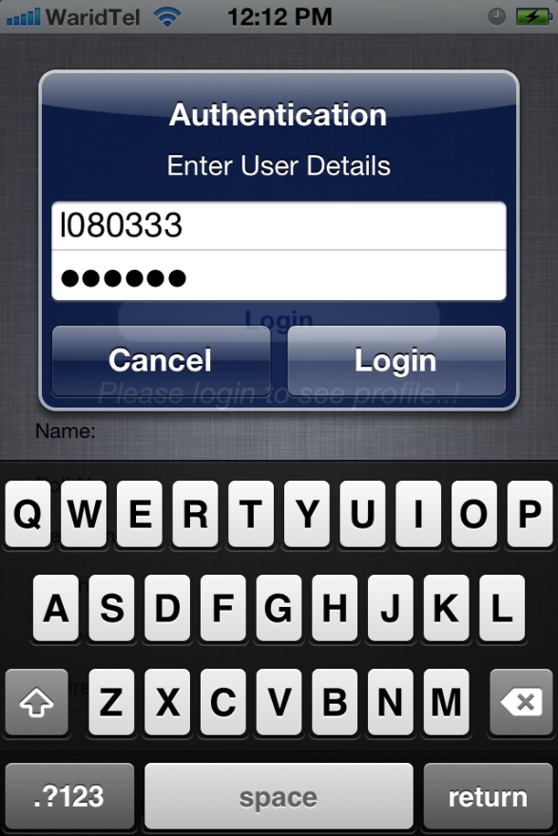
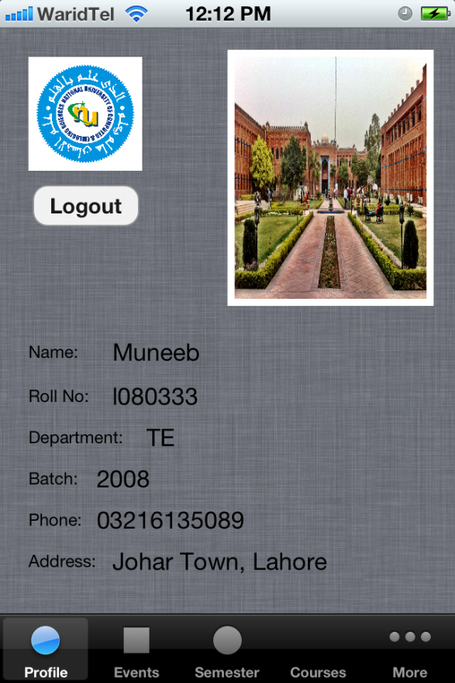
Snapshots

Slide 6
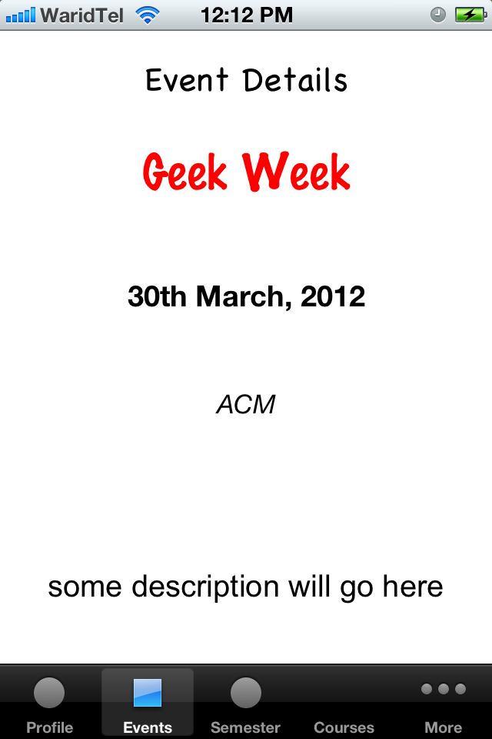
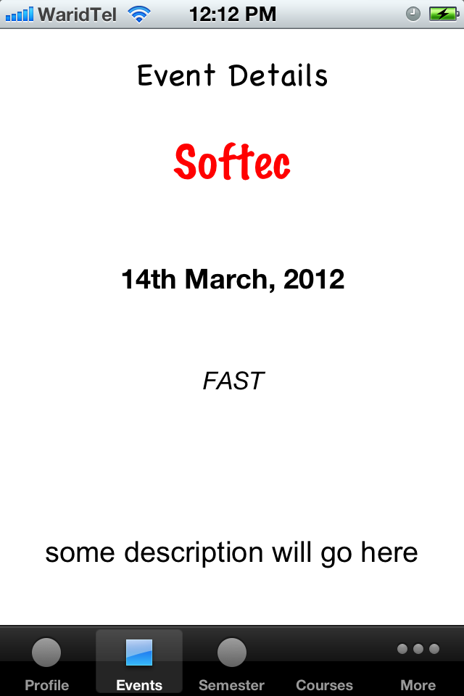
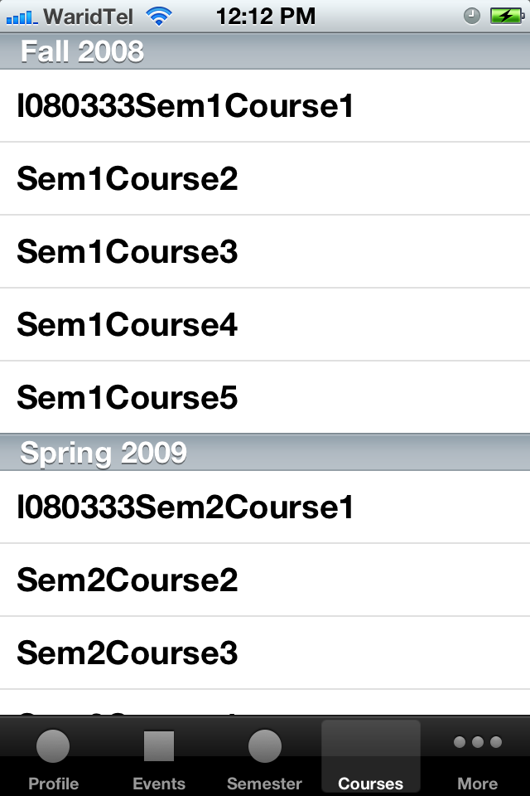
Cont.

Slide 7
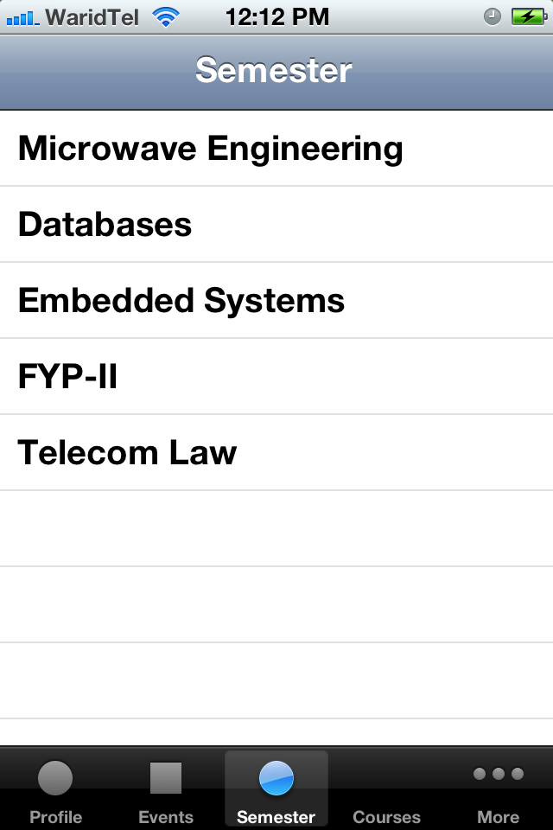
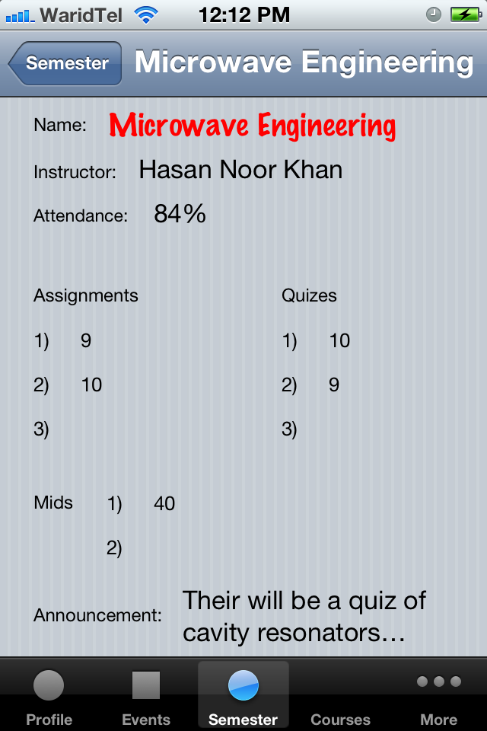
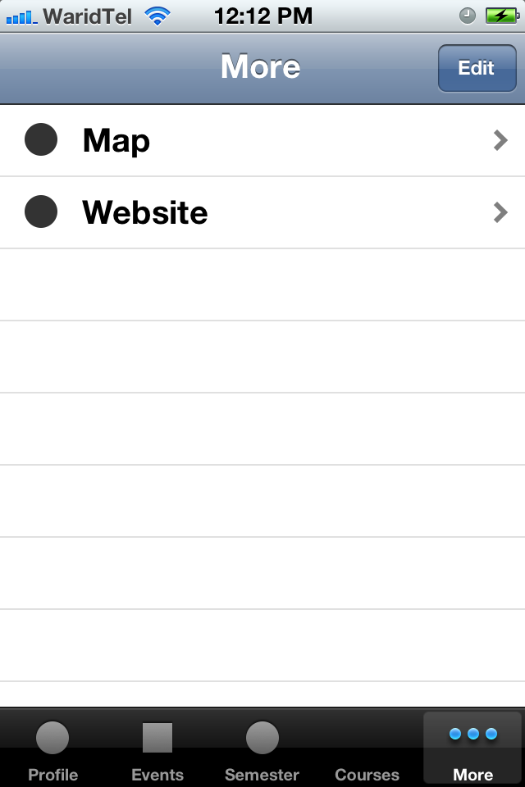
Cont.

Slide 8
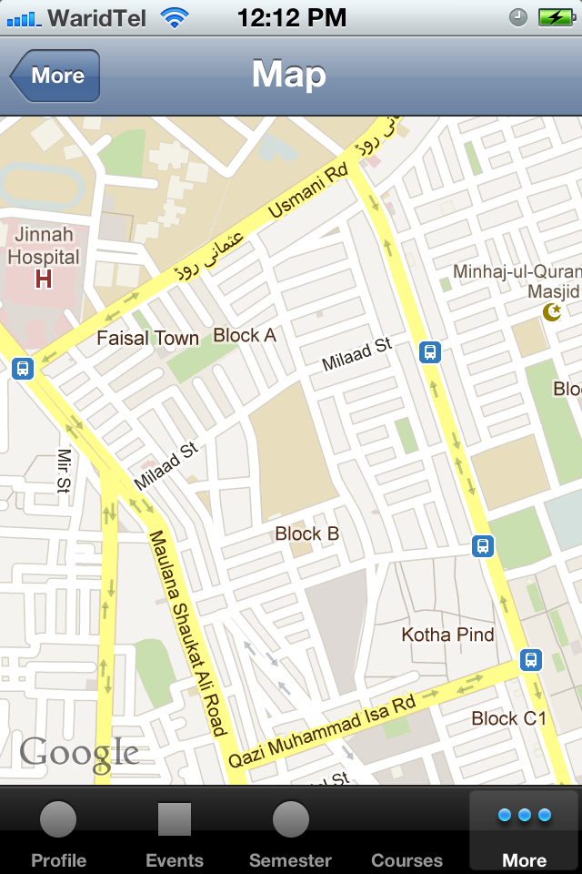
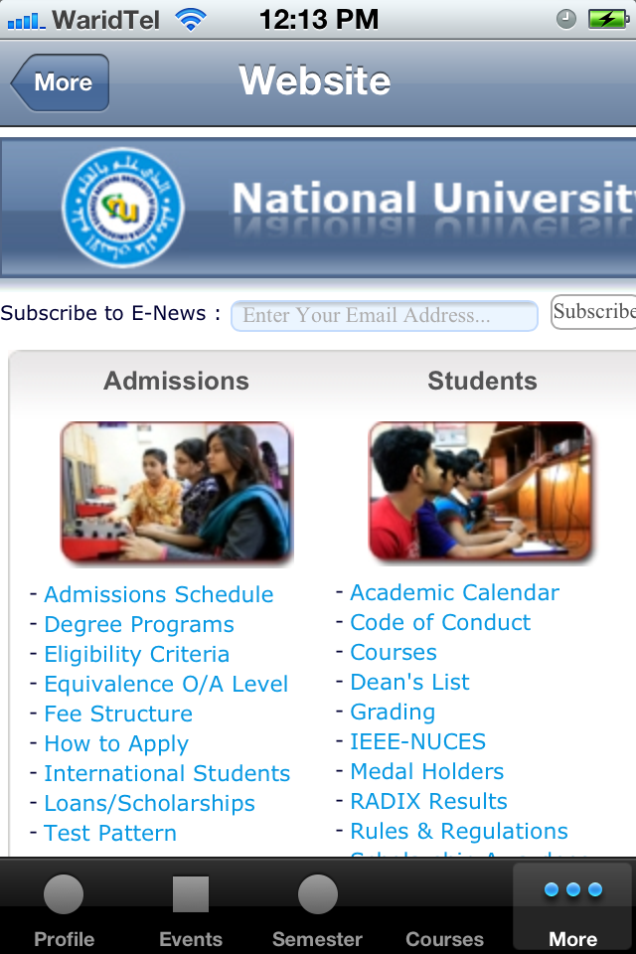
Cont.

